Slide 1
Introduction To Philippians
When was it written?
  Late 50’s early 60’s AD, while Paul was imprisoned at Rome. (Phil 1:12-14, Phil. 4:18-19)
Two whom was it written?
  Disciples and their leaders in Philippi (Phil 1:1)
Why was it written?
  Unity and joy despite hardships (Phil 1:27-30)
  Complaining and Arguing, Trust in God (Phil 2:12-18)
  False teachers harming convictions (Phil 3:1-6)
  Contentment despite circumstances (Phil 4:11-13)

Slide 2
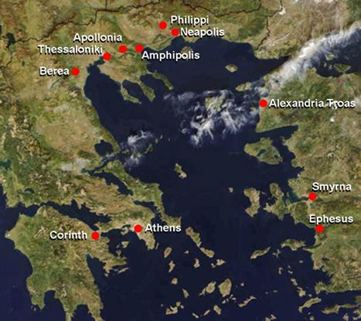
The Location of Philippi

Slide 3
Philippi – Points of Interest
The Ruins of Philippi near modern Kavalla in northern Greece.
It was then a city of Macedonia founded by Philip, the father of Alexander the Great.
Roman colony and military centre, governed directly from Rome
Situated on the Via Egnatian, the highway running east and west linking Rome to Byzantium (Istanbul).

Slide 4
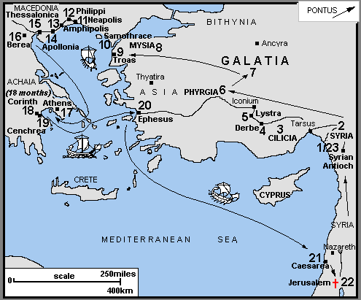
Paul’s 2nd Missionary Journey

Slide 5
How This Church Begins
Acts 16:6-40
The Willingness To Follow A Visionary
God Opens Hearts – So Open Your Mouth!
Pray For Each Other

